Slide 1

Unveiling Analog Input Reading Magic

Slide 2

LIST OF COMPONENTS:
ESP32 MICROCONTROLLER
POTENTIOMETER
BREAD BOARD
LED
JUMPER WIRES

Slide 3
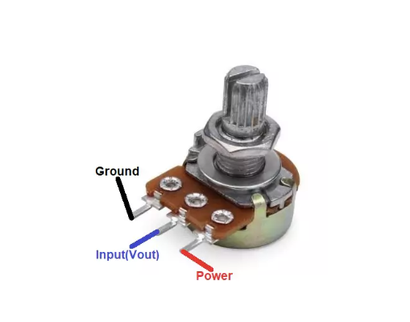
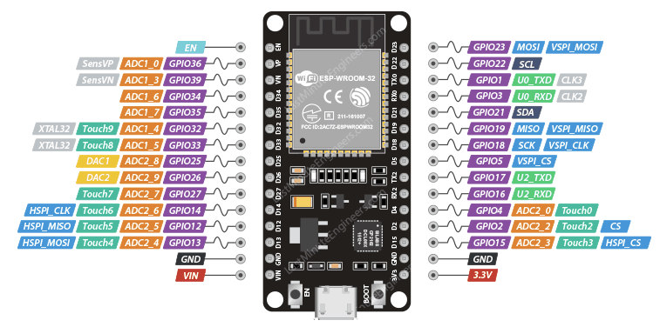
CIRCUIT DAIGRAM:
CONNECT GND-GND
VOUT-D34
VCC-VIN

Slide 4
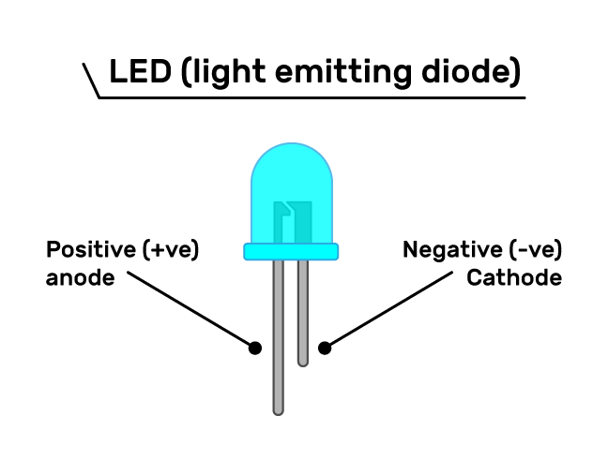
CONNECT ANODE-D13
CATHODE-GND

Slide 5
CODE:
#define LED_PIN 13
#define POT_PIN 34
void setup() {
pinMode(LED_PIN, OUTPUT);
pinMode(POT_PIN, INPUT);
Serial.begin(115200);
}
void loop() {
int potValue = analogRead(POT_PIN);
int ledBrightness = map(potValue, 0, 4095, 0, 255);
analogWrite(LED_PIN, ledBrightness);
Serial.print("Potentiometer Value: ");
Serial.print(potValue);
Serial.print(" - LED Brightness: ");
Serial.println(ledBrightness);
delay(1000);
}

Slide 6
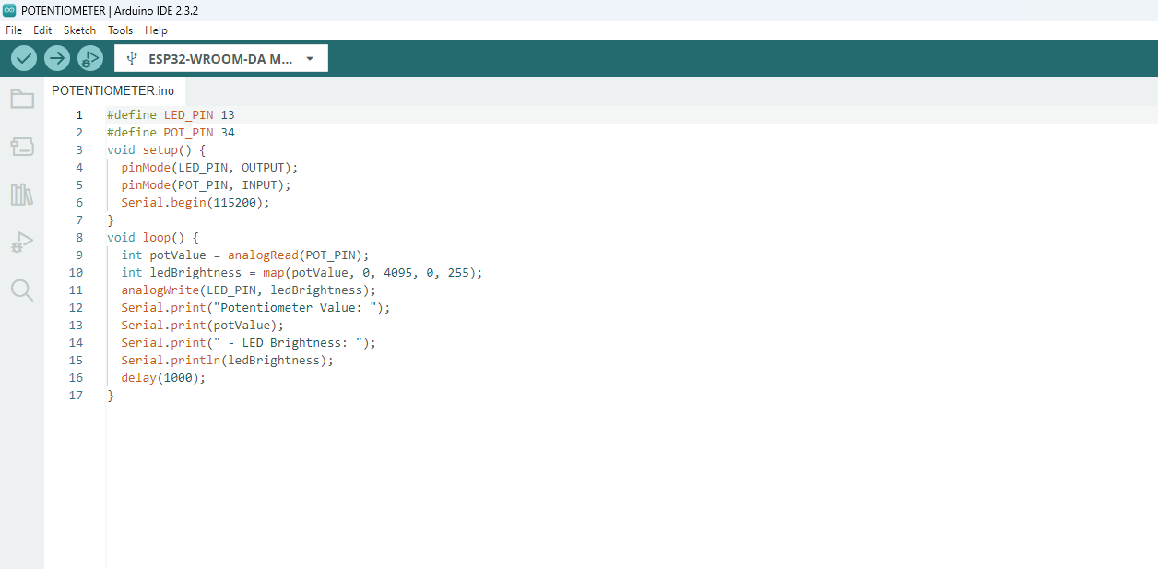
STEP 1:
Copy code paste in Arduino new Sketch

Slide 7
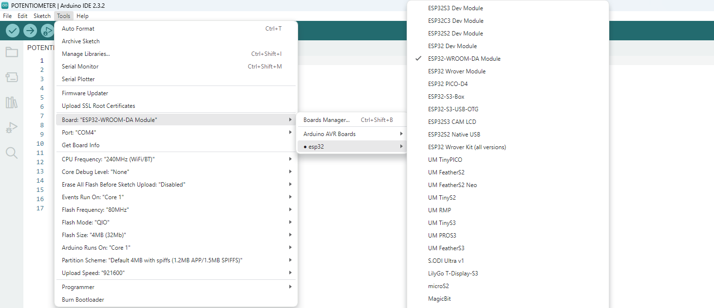
STEP 2:
Board---->esp32---->esp32-wroom-DA module

Slide 8
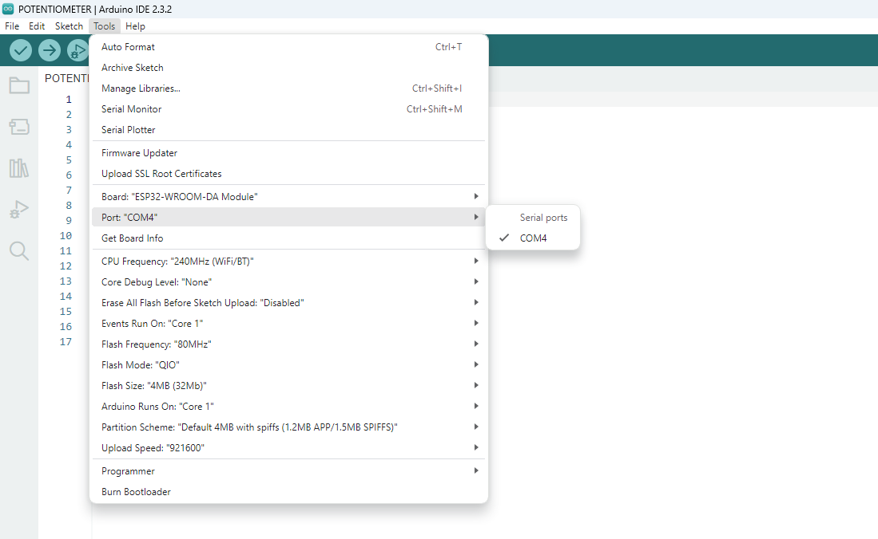
STEP 3:
Tools---->port---->select your com

Slide 9
board name automatically change to dark

Slide 10

Compilation build the code to board
1.Compile the code

Slide 11
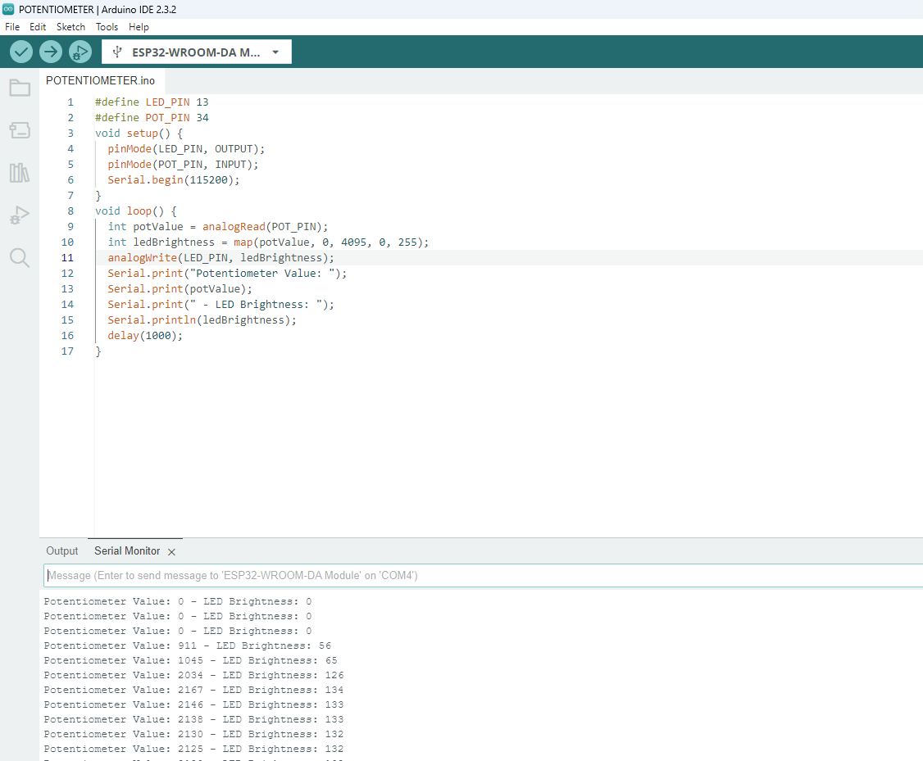
OUTPUT:
When we upload the code the LED will adjusted using the potentiometer and we can see the potentiometer and the LED brightness value
After Build the code the output like this

